Slide 1
Hackathon Project Final Presentation
January 21th, 2024
Team Entelligence
Atharva Kalamkar-Computational Engineering,
Muhammad Akmal-Petroleum and Geosciences Engineering,
Avya Kalra-Computational Engineering/Mathematics,
Mihir Yogesh Bendre-Computational Engineering,
Muhammad Taha-Computational Engineering.

Slide 2
Executive Summary
1. What is the problem?
Predicting Average Pump Difference to optimize fluid system selection, minimizing uncertainty in post-simulation planning, scheduling, and budgeting.
Utilization of accurate Data Analytics principle to evaluate Data sources with varying uncertain features.
Feature Selection was made difficult due to NaN & Hidden values adding to the complexity in Transforming features.
Developing Data-driven Machine learning model to not only find missing data but to avoid uncertainty below 45 degree based of an accuracy plot
2. What did your team do to address the problem?
Cleaned data by removing Nan values and Impute data by implementing KNN Imputer.
Feature Selection ranking was obtain using Kendall Correlation Matrix (coverage).
Splitting Data in Training(80%) and Prediction(20%) datasets.
Grid Search Algorithm.
3. What did your team learn?
Our team learned not only principles of Data Analysis and ML but also the ability support members due to circumstances they encountered in their learning journey.
We learned to ask the right questions and formulate thoughtful ideas to address the problems specific goals.
General sequence to solve a machine learning problem.
4. What does your team recommend going forward?
Create a plan of action and meet the agreed upon Target schedule.

Slide 3
Workflow
Importing Libraries and Dataset: pandas, numpy, pickle, matplotlib, metrics.
Data Cleaning and Imputation: KNN Imputer, Normalizing Data.
Data Overview: The head, shape, and body of the data.
Feature Engineering/ Feature importance: Matrix Correlation/ Coverage.
Data Preprocessing: k-fold cross validation.
Trying various Machine learning models: Linear, Random Forest & SVR models.
Uncertainty realizations- Bootstrapping.

Slide 4
Workflow
Interesting Features of our workflow.
MinMax Scaler to normalize.
LabelEncoder
KNN imputation
K-fold cross validation with 3 splits.
Supported Vector Regression model.
Bootstrapping for uncertainty.

Slide 5
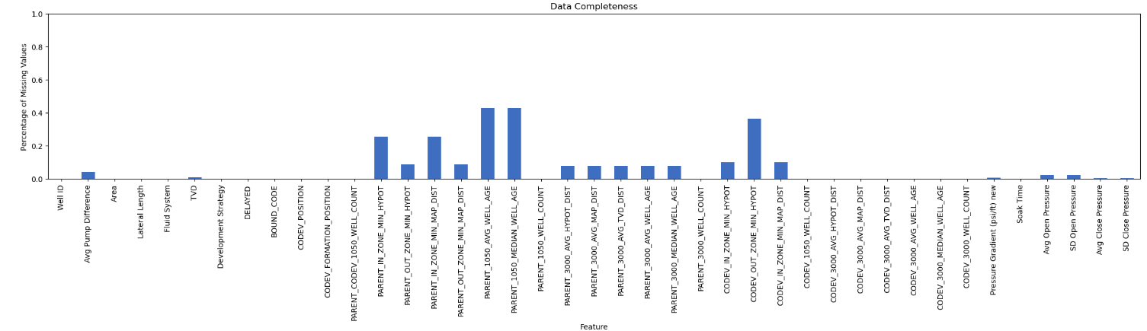
Feature Ranking: Coverage
Built using code from Michael Pyrcz- https://github.com/PGEHackathon/workshop/blob/main/03_feature_selection/workflows/SubsurfaceDataAnalytics_Feature_Ranking.ipynb

Slide 6
Top 10 important features according to RFR:
Pressure Gradient (psi/ft) new: 0.2932827509554326
Avg Open Pressure: 0.20417609290139727
Young: 0.07121598167122084
Avg Close Pressure: 0.036625904574021324
SD Open Pressure: 0.03255641237272558
TVD: 0.027239152465323078
Soak Time: 0.02356038635426811
SD Close Pressure: 0.023214455233728733
Williams: 0.023043572928056054
Lateral Length: 0.021720527794143504

Slide 7
Top 10 important features according to GBR:
Pressure Gradient (psi/ft) new: 0.27266378562541954
Avg Open Pressure: 0.2466867373762129
Young: 0.10625920679656184
Avg Close Pressure: 0.0375084615555857
Lateral Length: 0.034039939345346805
Soak Time: 0.027296508507642075
SD Open Pressure: 0.02153542773496318
Williams: 0.021058980585256667
TVD: 0.017611214543896983
SD Close Pressure: 0.016800279225412742

Slide 8
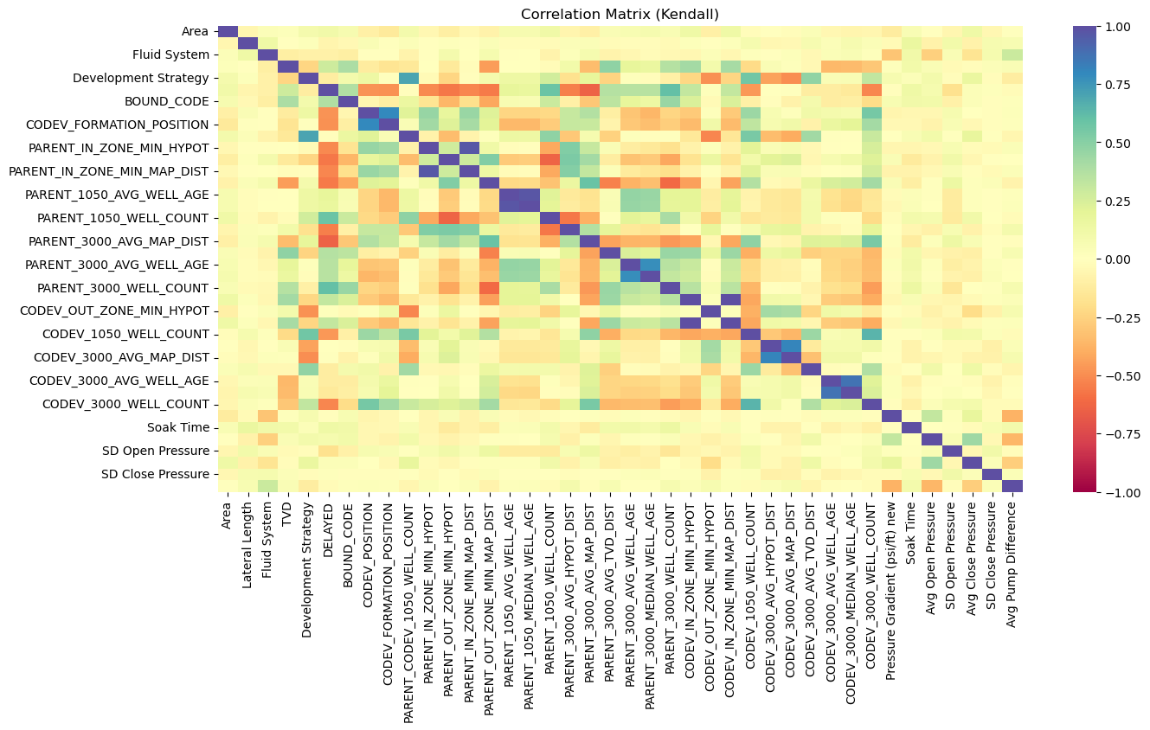
Correlation Matrix

Slide 9
Results and Discussions
Well_ID | Est Pump Difference, GPM | Mean Uncertainty Realization
4 | 41.1179031 | 0.25932501
31 | 22.771435 | 0.25740486
42 | 0.75269254 | 0.2495351
52 | 3.52464607 | 0.26248701
71 | 57.0812733 | 0.24733865
76 | 10.2987739 | 0.24998092
96 | 16.2081189 | 0.28574301
131 | 6.20786429 | 0.26934266
137 | 2.74510175 | 0.23555818
194 | 55.9808203 | 0.26070163
220 | 11.4006227 | 0.26645186
236 | 30.0309552 | 0.25793133
265 | 33.9005478 | 0.23633037
321 | 9.71373171 | 0.23689034
345 | 1.67934868 | 0.25361019

Slide 10
Feedback
What did your team learn?
We learned to ask the right questions and formulate thoughtful ideas to address the problems specific goals.
General sequence to solve a machine learning problem.
What did your team like?
We greatly appreciate the constant constructive feedback and support by the Architects, the Mentors and our beloved Professors.
Constant provisions of food and coffee were a real savior.
The *wisdom* that we gained.
What could we do to improve next year?
Very well organized, nothing to improve
Stronger coffee

